Slide 1
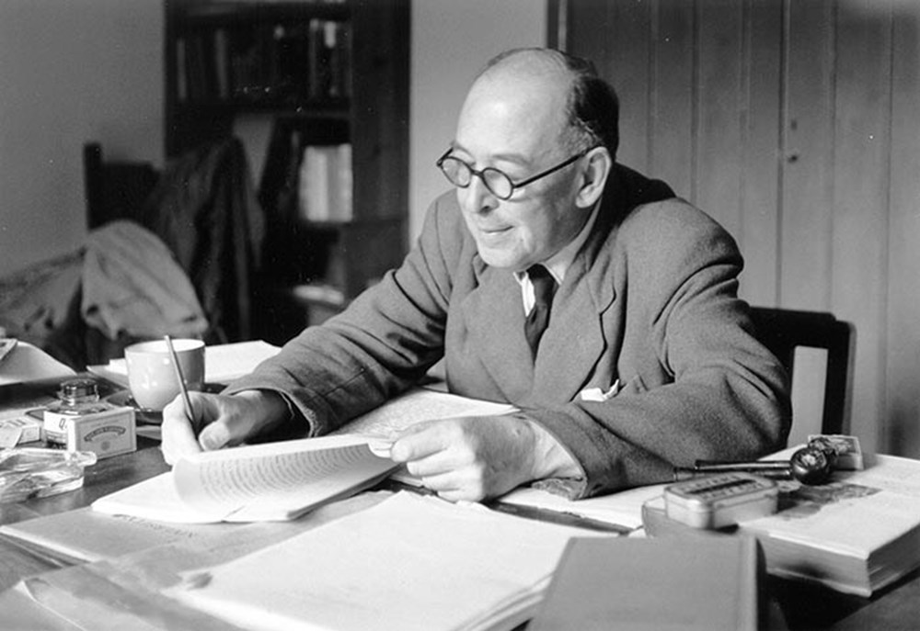
COURAGEOUS ADVOCATE of the WEEK
C.S.Lewis
“True humility is not thinking less of yourself; it is thinking of yourself less.”
What do you think CS Lewis meant by this?

Slide 2
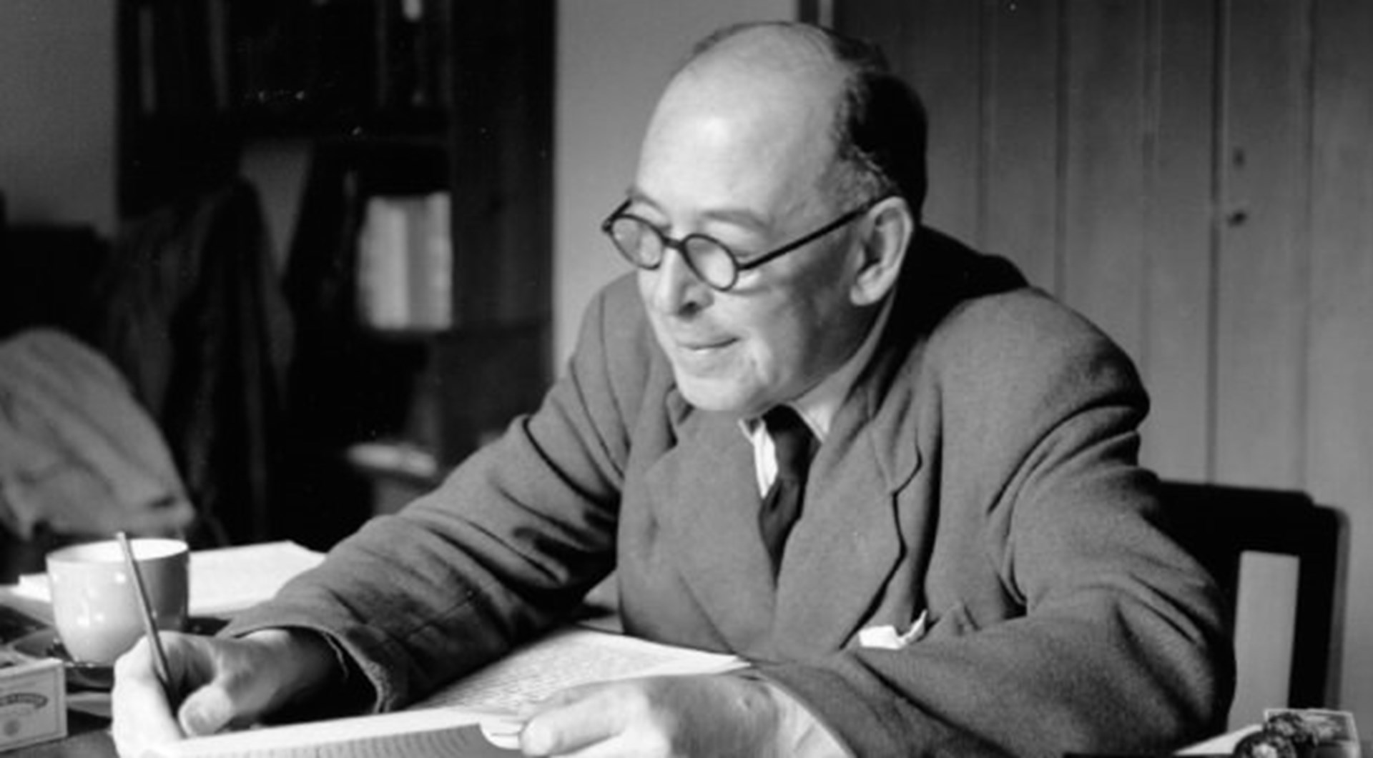
This year, Advent Sunday (29th November) fell on the birthday of a great author and Christian disciple: C. S. Lewis. He was born in 1898.
His full name was Clive Staples Lewis, but his friends and family called him Jack.
When CS Lewis was younger, he was an atheist. This means that he did not believe in God.

Slide 3
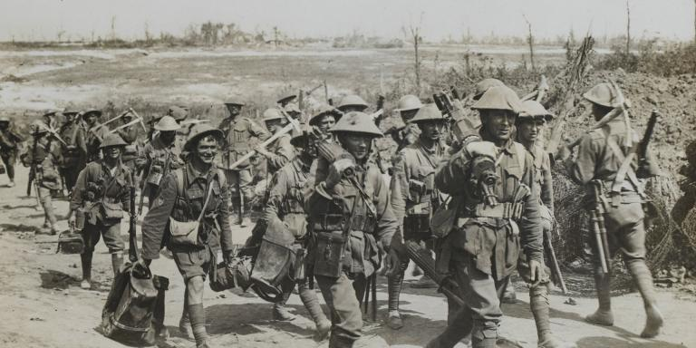
As a young boy, CS Lewis loved reading and particularly enjoyed the Beatrix Potter stories.
He wrote his own animal stories too.
C. S. Lewis fought in the trenches in the Somme Valley in France during World War 1. He was wounded in April 1918 and returned to Britain. He was seeking meaning for his life.

Slide 4
As a young adult, he had a group of friends, with whom he used to spend a lot of time talking through ideas. One of these friends was JRR Tolkien, who wrote The Lord of the Rings series of books.
It was through these talks that CS Lewis began to discover his belief in God. He realised that God gave him strength in the hard times and that God answered prayer, not by answering demands but by providing JOY through the amazing creations of nature, books and music.
“I believe in Christianity as I believe that the
sun has risen: not only because I see it, but
because by it I see everything else.”
What do you think this quote is saying?

Slide 5
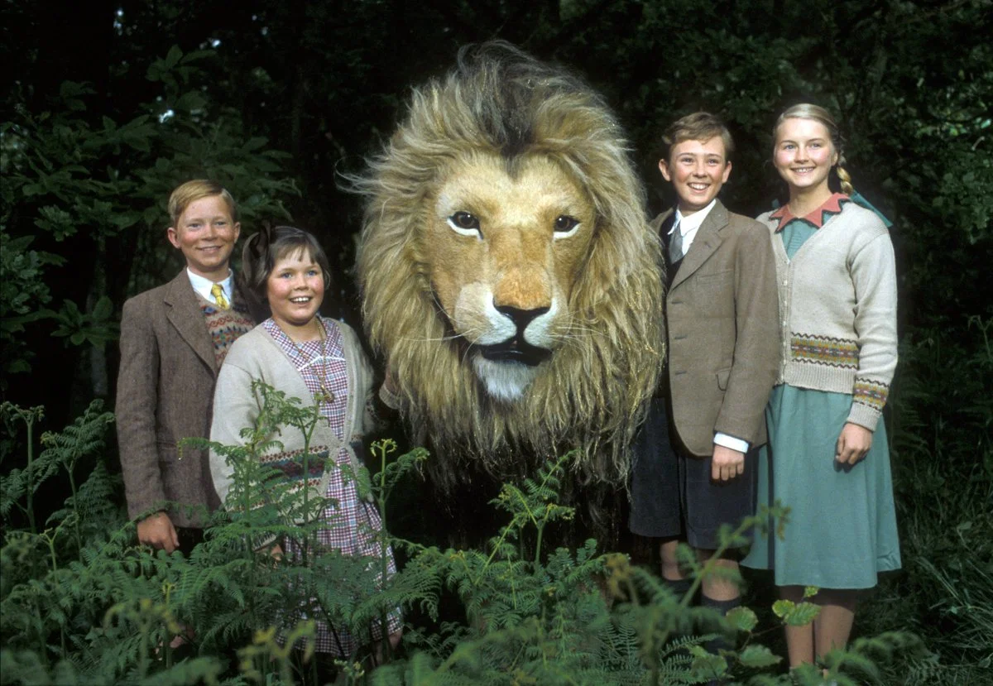
After becoming a Christian, CS Lewis wrote many books on the subject
His most famous series of novels was The Chronicles of Narnia.
These books for children, written between 1949 and 1954, were written to present Christian ideas in way that was able to be understood by children.
Aslan (the lion character in The Lion, the Witch and the Wardrobe) for example, represents Jesus. Aslan sacrifices his life for the good of others. He resurrects the next morning and defeats evil.

Slide 6
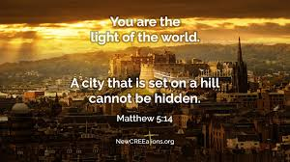
Special Quote: “Don’t shine so others can see you. Shine so that through you others can see Him.”

Slide 7
Dear God, We thank you for the joy that reading brings to so many. We thank you for our eyes to see the writing and the pictures in our books. We thank you for our ears to listen to all the wonderful stories we are told. We thank you for the most precious book of all; the Bible, our very own love letter from you. Please help us to use the words to ensure others see and hear the glory of your name. Amen

