Slide 1
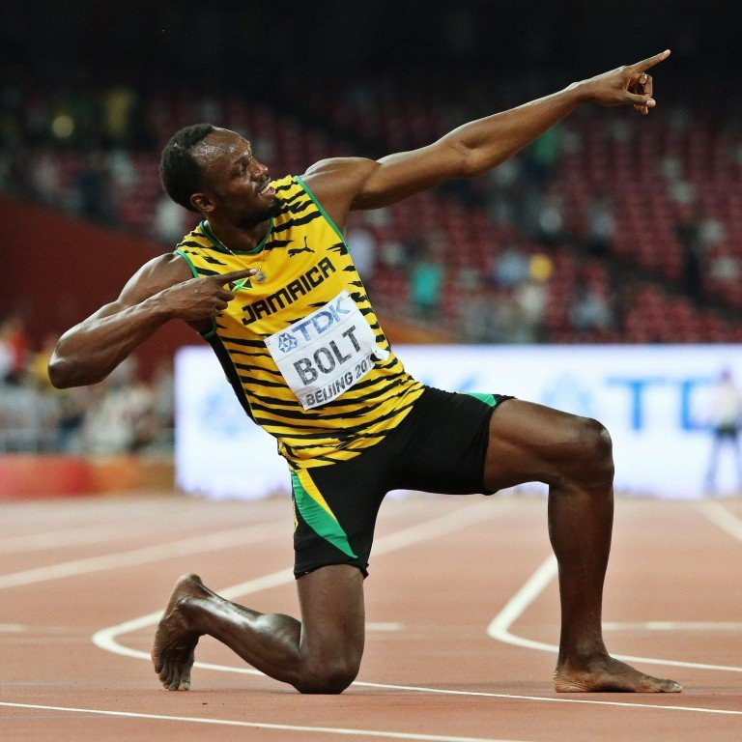
COURAGEOUS ADVOCATE of the WEEK
Usain St Leo Bolt

Slide 2
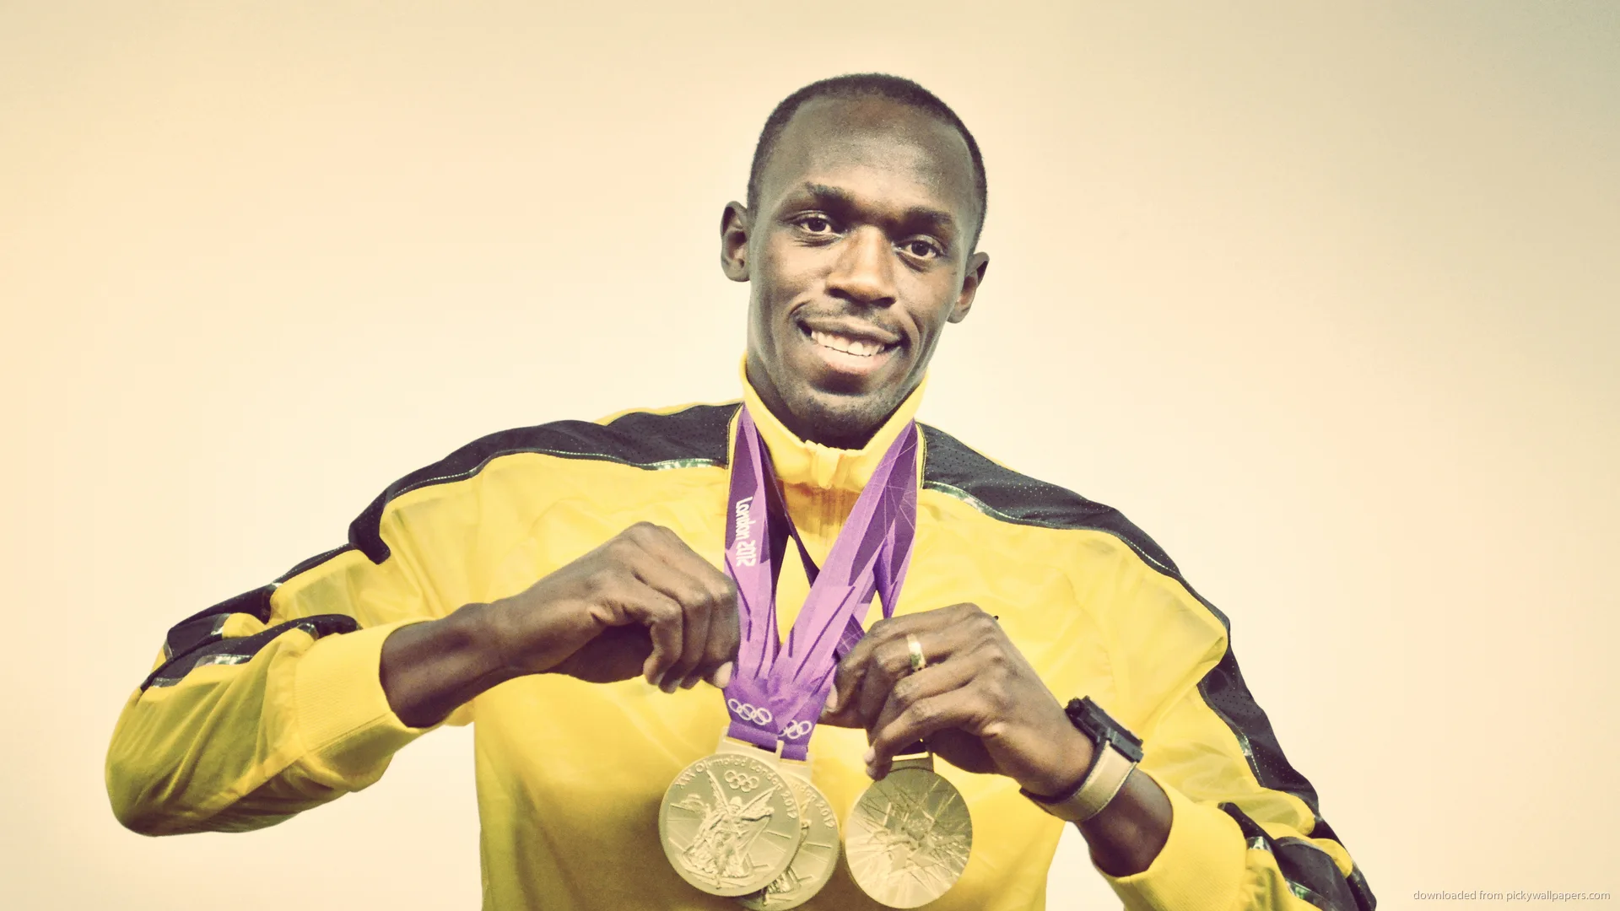
Usain St Leo Bolt is considered to be the greatest sprinter of all time, winning many Gold medals and breaking lots of world records.
His nickname is ‘Lightning Bolt’!
Usain Bolt won 8 gold Olympic medals, and is the only sprinter to win the Olympic 100 m and 200 m titles at three consecutive Olympics (2008, 2012 and 2016)

Slide 3
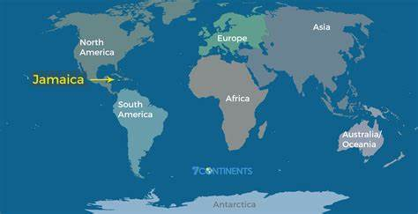
.
Usain Bolt was born on 21 August 1986 to parents Wellesley and Jennifer Bolt in a small town in Jamaica, an island in the Carribean. His parents ran the local grocery store, and Bolt spent his time playing cricket and football in the street with his brother.

Slide 4
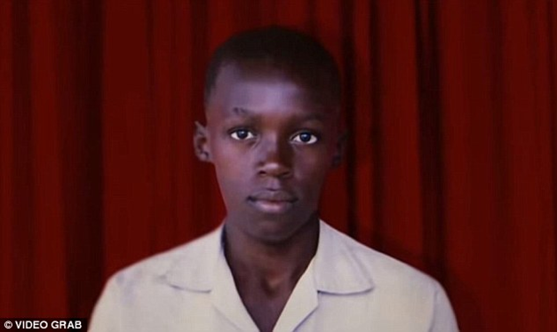
As a boy, Bolt attended Waldensia Primary School. His exceptional talent began to show when he ran in national primary school competitions. By the age of twelve, Bolt had become the school's fastest runner over the 100 metre distance.
When he started High School, Bolt continued to focus on other sports, until his cricket coach noticed how fast he was on the pitch and urged him to try track and field events.
Bolt won his first High School championship medal in 2001 - the silver medal in the 200 metres. He began to train more seriously, although he did often play practical jokes on his Coach!

Slide 5
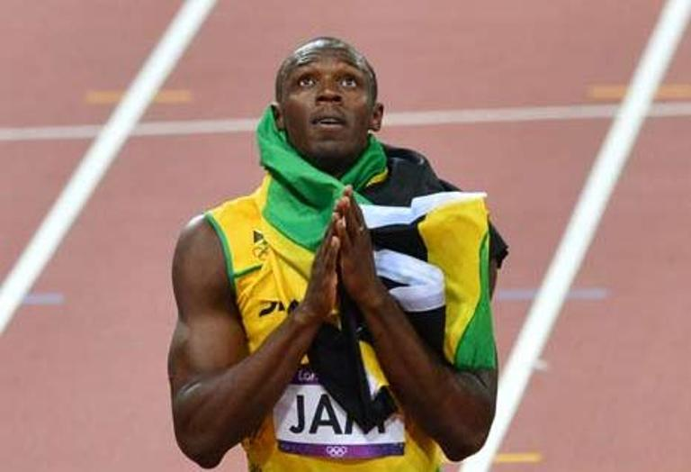
Bolt loved going with his mother to church as a boy, and his faith as a Christian has grown with him.
His middle name ‘St Leo’ comes from one of the early leaders of the Church.
Usain is well known for his Lightning Bolt action to celebrate his wins.
But less well known is how his faith inspires him every day. Bolt makes the sign of the cross and offers up a silent prayer before each race.

Slide 6
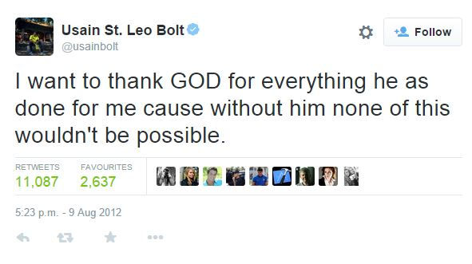
Usain's faith is centered around praise and gratitude.
He thanks God for giving him his talents.
Usain Bolt has always been a great advocate of giving back to those less fortunate than himself and almost five years ago, he started the Usain Bolt Foundation.
It helps children to get the education and healthcare they need to live happy, successful lives.

Slide 8
We pray together for God’s help to use our talents wisely.
Help us all to use the gifts you have given us to always do our very best.
We pray for children all over the world, that they may all have the chance to learn new skills and to use their talents to make the world a better place.
Amen

