Slide 1
COURAGEOUS ADVOCATE of the WEEK
Hea Woo, North Korea

Slide 2
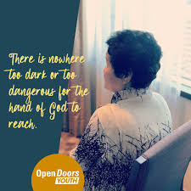
Hea - Woo (this isn’t her real name) is an incredibly brave lady from North Korea – a place where people do not have freedom to live their lives in the way that we do in the UK. It is against the law to believe in Jesus.

Slide 3
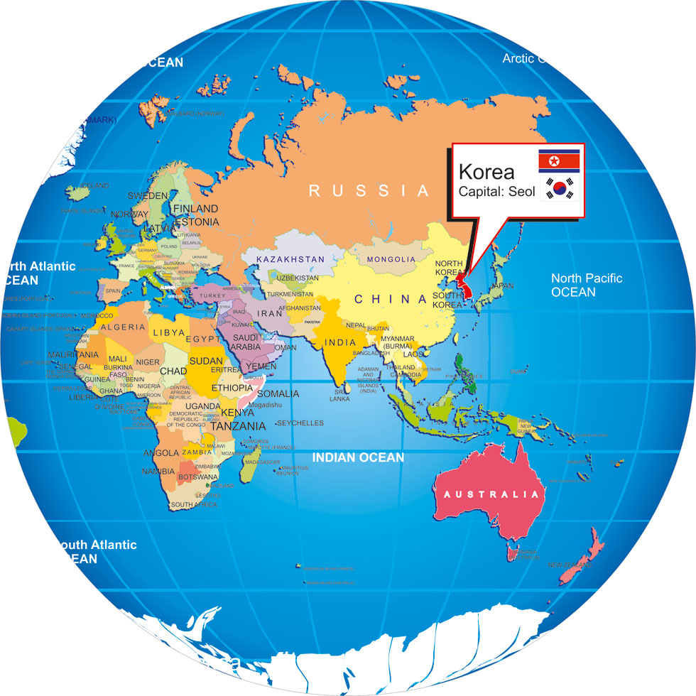
Can you find North Korea
and the UK on this map?

Slide 4
Hea Woo’s husband was put in prison, when their children visited him, he wanted to pass on his faith to them, but there were guards everywhere. So, he did something simple but very brave…he wrote three words on his hand:
“Believe in Jesus.”

Slide 5
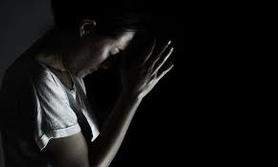
Hea Woo was put in prison for trying to run away from terrible conditions to a new country. She had to work very hard, with very little food. She said that although this was very hard, “something harder was that we did not have freedom of faith. We could not pray freely but I still prayed in my heart. When people were asleep, I woke up to pray. It was so pitiful that we did not have freedom of faith; I really yearned for freedom.”

Slide 6
Hea-Woo wasn’t allowed to sing in prison so she would wait until there was a very heavy rainstorm, at night, and go to the outdoor area and risk singing praises to God.

Slide 7
Thankfully,Hea Woo escaped to China and now lives in freedom in South Korea. “Wherever God calls me to go I obey His calling and travel all around the world to share my testimony. I am God’s trumpet to speak out His will. Wherever I go and whatever I do, I want to glorify Him only.”

Slide 8
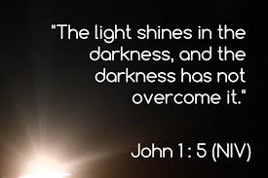
Special Bible verse
How does this verse fit in with Hea -Woo’s life?

Slide 9
What can we do?

