Slide 1
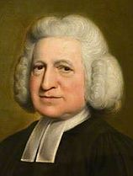
COURAGEOUS ADVOCATE of the WEEK
Charles Wesley
(1707-1788)

Slide 2
Charles Wesley was born on
the 18th December 1707.
He was an English leader of the Methodist
Movement and is most widely known for writing
about 6,500 hymns.

Slide 3
Wesley was born in Epworth, Lincolnshire, the son of Anglican cleric and poet Samuel Wesley and his wife Susanna.
He was a younger brother of Methodist founder John Wesley and Anglican cleric Samuel Wesley the Younger, and he became the father of musician
Samuel Wesley and grandfather of musician Samuel Sebastian Wesley.

Slide 4
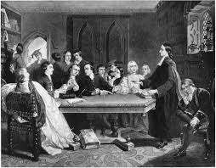
Charles Wesley was educated at Oxford, where his brothers had also studied. He formed the "Holy Club” at Christ Church, Oxford with his brother John Wesley.
The brothers and their friends met for prayer and Bible study.

Slide 5
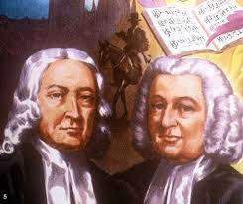
Charles followed his father and brother into the church in 1735, and he travelled with his brother John to Georgia in America, returning a year later.

Slide 6
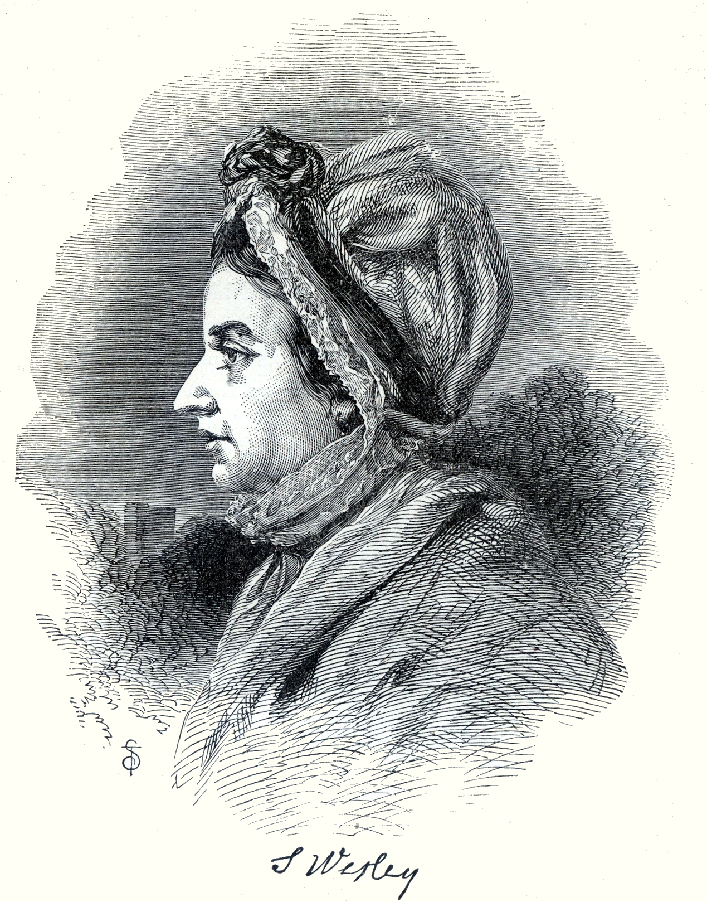
In 1749, he married Sarah Gwynne, daughter of a Welsh gentleman who had been converted to Methodism. She accompanied Charles and his brother on their evangelistic journeys throughout Britain until Charles stopped travelling in 1765.

Slide 8
How can you show praise to God for all he has blessed us with?

Slide 9
Here is one of his well-known hymns of praise that is still popular today to praise God.
Do you recognise it?

Slide 10
Prayer
O Lord, you are the God of all hope.
You fill our lives every day with great joy.
You bring peace and love, and guide us when we need your help the most.
We pray that you watch over each member of our school family, and continue to bring HOPE to all peoples around the world, at this time.
You know our daily struggles and worries, and you are always there to love us and care for us.
Help us to care for all those in need, that we can share your love and peace, to bring HOPE into their lives.
We ask this in Jesus’ name. Amen.
Give Thanks to God

