Slide 1
COURAGEOUS ADVOCATE of the WEEK
Michael Ebenezer Kwadjo Omari Owuo Jr.
26 July 1993

Slide 2
Last week we learnt about the Courageous Advocate J.S. Bach. This week we are leaving history behind with this weeks Courageous Advocate……..

Slide 3
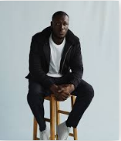
COURAGEOUS ADVOCATE of the WEEK
Michael Ebenezer
Kwadjo Omari Owuo Jr.
Best known as
Stormzy

Slide 4
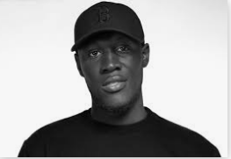
Stormzy grew up in South London with two older sisters and brother. He was raised by a single mother.
He began rapping at the age of 11, and released his debut album in 2014.

Slide 5
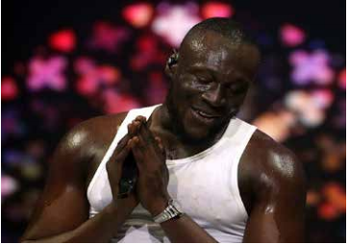
Stormzy gained massive popularity in mainstream UK culture as well as inside the younger generation within the Church.
Through his music Stormzy wants to harness some of the spirit he’s felt in church.
His rap music is challenging, contemporary and quite powerful music called ‘Grime’.

Slide 6
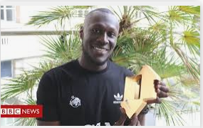
It is said that Grime is bringing religion back to the forefront of culture.
J. P. Patterson, editor-in-chief of Trench magazine and member of the Mobo Awards Council said,
“Stormzy has brought God and grime together in such a cool way. The man has stadiums singing about Jesus, waving their hands, and that should be celebrated.
He could easily forget where he’s come from and who got him here, but he hasn’t.”

Slide 7
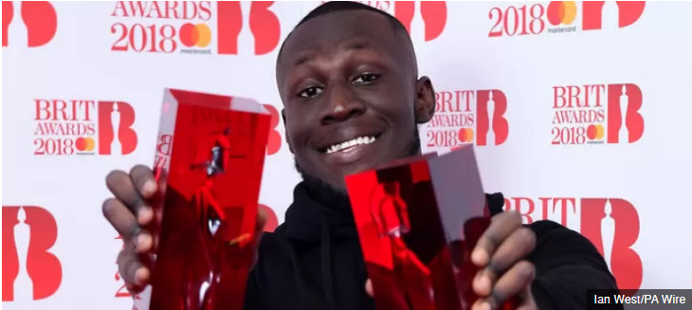
Stormzy won two awards in 2018 at the Brit Awards and gave thanks to God after winning.
He became overwhelmed as he was announced as the winner, so overwhelmed that he fell to the ground in shock.
Accepting his prize, the rapper told the audience,
"Firstly, I always give all the glory to God, God this is all you, this is all you God. I know that a lot of people, when I give the glory to God, it seems such a strange thing, but if you know God, you know it's all him."

Slide 8
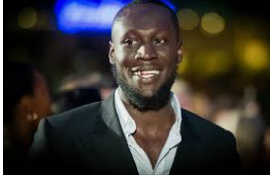
Every award I’ve ever collected, whatever achievement I’ve ever had, I’ve always been vocal about the fact that it’s not possible without God.
He’s the reason why I’m here today. He’s the reason that I’m able to have a career.
What is Stomzy saying here?

Slide 9
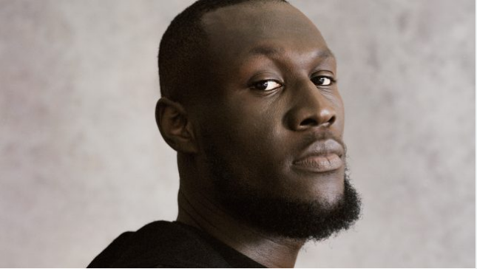
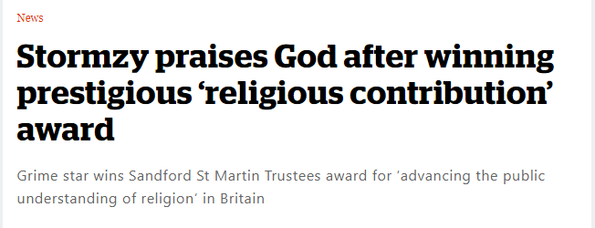
Stormzy has also won a prestigious faith award for his contribution to the “public understanding of religion.”
The grime star, who has rapped about his faith in God, will receive the 2020 Sandford St Martin Trustees’ Award from the Bishop of Ripon, the Rt Revd Dr Hartley.
The Rt Revd Dr Hartley said “The openness and clarity about which Stormzy speaks and sings about his faith and the efforts he’s made to translate that into action resonates with people around the world who have heard his music on the radio, seen him perform on television or watched his videos online.”

Slide 10
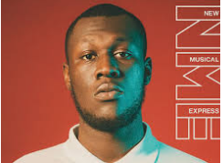
Stormzy has consistently expressed his faith and spirituality throughout his music. The rapper frequently makes references to God and received major chart success from his single ‘Blinded By Your Grace Pt.2, which is an ode to his religious side.
“I said a prayer this morning I prayed I would find the way To another day, I was so afraid 'Til you came and saved You came and saved me And the rain was pouring 'Cause the sun faded away Now I'm in a better place No longer afraid Blinded by your grace You came and saved me.”
Listen to Stormzy
Blinded By Your Grace
1:06 min to 4:35 min

Slide 11
Special Bible Verse Then I called on the name of the LORD: "O LORD, save me!" The LORD is gracious and righteous; our God is full of compassion. The LORD protects the simple hearted; when I was in great need, he saved me. Be at rest once more, O my soul, for the LORD has been good to you. Psalm 116

