Slide 1
COURAGEOUS ADVOCATE of the WEEK
Reverend Rose Hudson-Wilkin

Slide 2
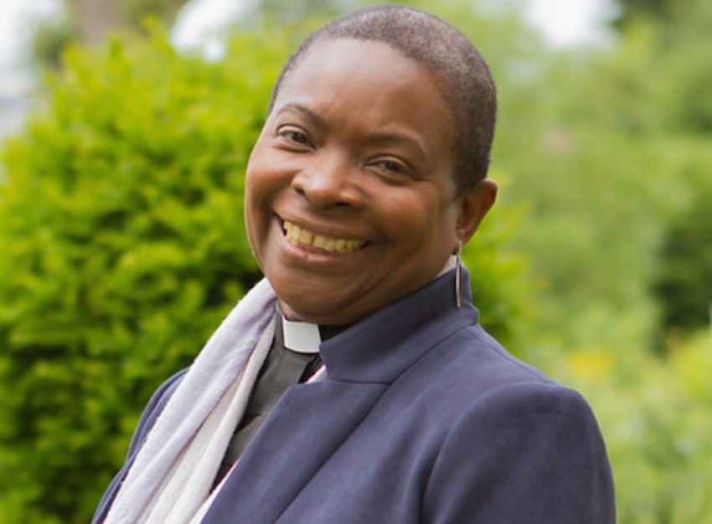
Reverend Rose Hudson-Wilkin was the first black woman to become a bishop in the Church of England.

Slide 3
Reverend Rose was born in 1961 in Jamaica and was raised by her father and her aunt after her mother went to England not long after she was born. At the age of 14 she felt that she had been called to join the ministry, yet no women were allowed to hold such roles in the church at this time. She said she “never believed any of that stuff” and knew that God had called her “to preach his Good News.” Rose was determined to pursue her mission and headed to England to join the Church Army College in London, a place where women were allowed.

Slide 4
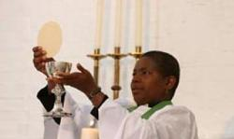
In 1991, Rose was ordained as a deacon and 3 years later she was ordained as a priest, one of the first groups of women in her diocese.

Slide 5
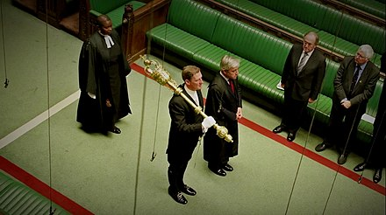
In 2007 she was appointed to the chaplain of the Queen and in 2010 to the chaplain of the Speaker of the House of Commons, the first woman and black person.

Slide 6
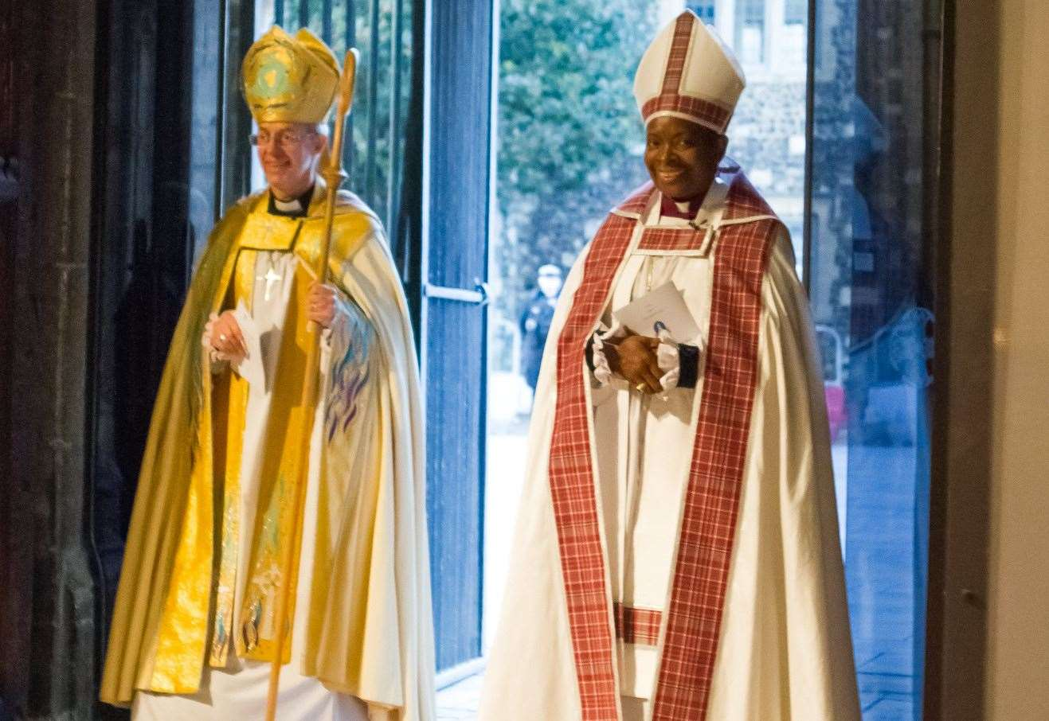
In November 2019 she was appointed to the Bishop of Dover.

Slide 7
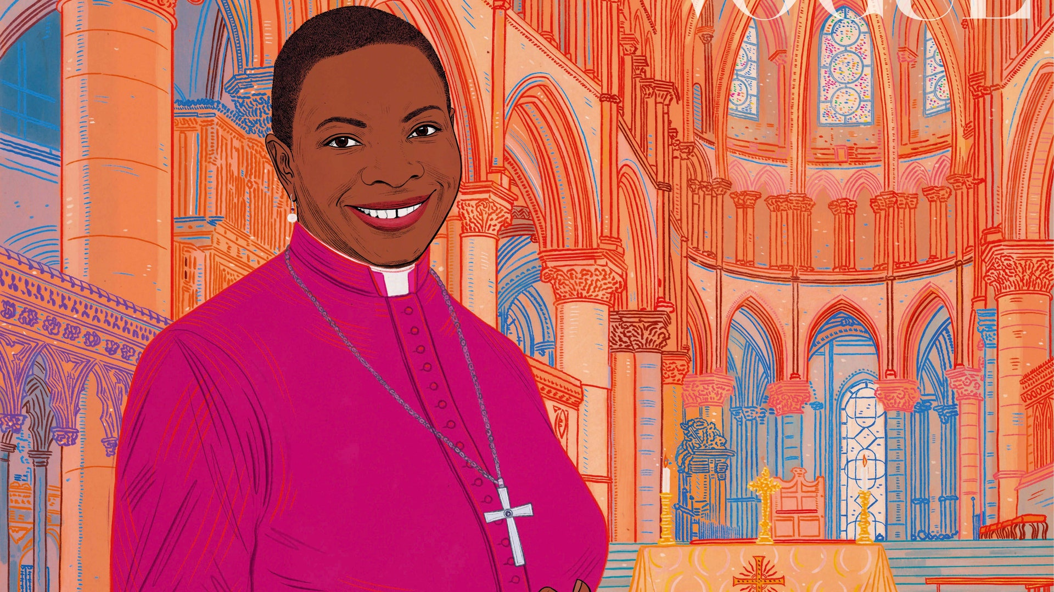
Although Reverend Rose has been the subject of racism and criticism in her life, she has remained focused on her message to spread the word of God and hopes ‘the Holy Spirit will change people’s hearts.’

Slide 8
Almighty Lord God, Help us to have the strength and confidence in our lives to make the right choices. Help us to love each and every one of our neighbours just as you love us. Help us to pursue our dreams and desires with you as our guide in life. We ask this in Jesus’ name, Amen.

